Slide 1
Machine Learning in R
Young Data Analytics Working Group

Slide 2

What is Machine Learning?
Deals with the problem of extracting features from data to make predictions:
Forecasting (e.g. sales, demand for insurance products)
Classifying (e.g. credit risk assessment)
Detecting anomalies (e.g. cases of insurance fraud)
Find patterns that generalise beyond the data, and which can be used to predict outcomes for new data you haven’t seen.
Machine learning models are built using the training data
Their suitability is tested against the validation data

Slide 3
Pre-processing the data
Have a clear understanding of:
Data
Clean data for missing values; deal with outliers
Data types (e.g. Are the inputs labelled or unlabelled)
Feature Engineering – Process of going from raw data to ready to model data
Visualise data
Constraints
Data storage
Do the predictions have to be fast – E.g. In autonomous driving, classifying road signs quickly is important
Does learning have to be fast – Is it necessary to train models quickly

Slide 4
Machine Learning Model Considerations
Does the model meet the business goals
How explainable is the model
Accuracy of the model
How fast is it to build and make predictions with the model
Scalability of the model

Slide 5
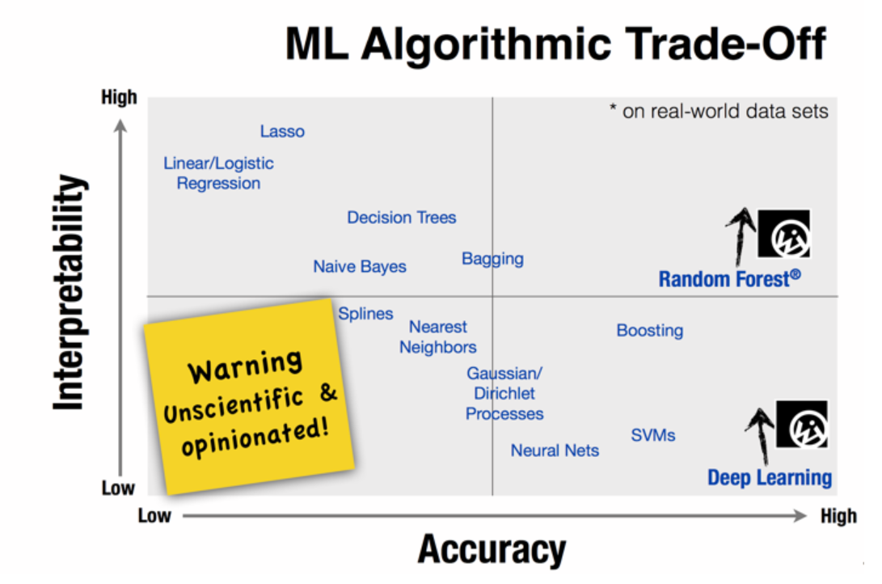
Source: Choosing the right machine learning algorithm,
https://hackernoon.com/choosing-the-right-machine-learning-algorithm-68126944ce1f

Slide 6
Algorithms Covered
Linear Regression
K-Means Clustering
Random Forest

Slide 7
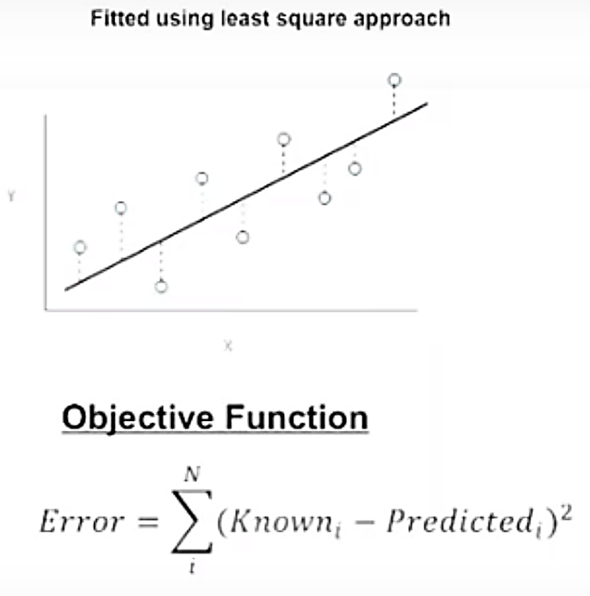
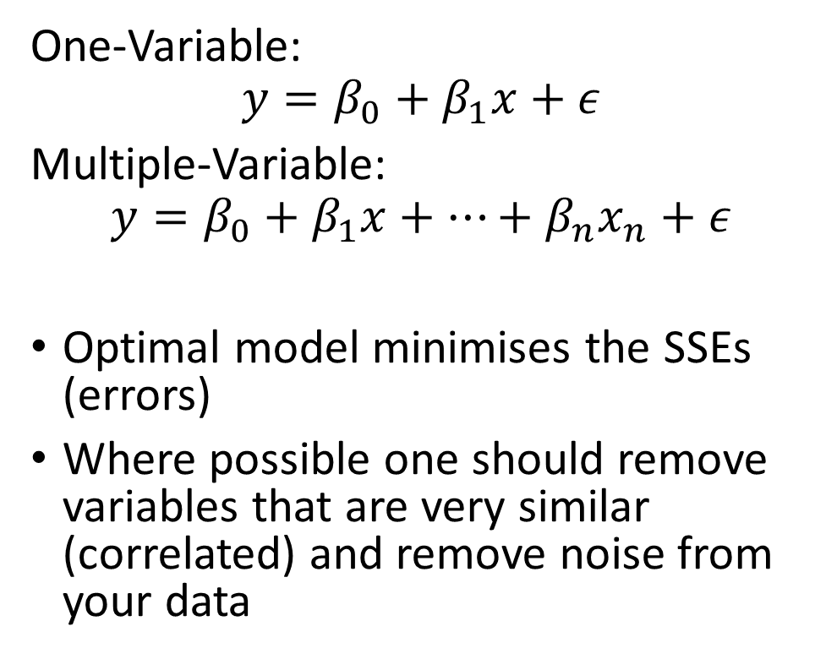
Linear Regression
One-Variable:
$$y=β_{0}+β_{1}x+ε$$
Multiple-Variable:
$$y=β_{0}+β_{1}x+…+β_{n}x_{n}+ε$$
Optimal model minimises the SSEs (errors)
Where possible one should remove variables that are very similar (correlated) and remove noise from your data

Slide 8
Linear Regression
Advantages
Fast, simple and widely used
Disadvantages
Assumes a linear relationship
Uses
Good first algorithm to try to gain insights into the relationship between the response variable (Y) and predictor variables (X)
Results are interpretable
Assumes independence within the dataset
Sensitive to outliers
Focuses on the relationship between the mean of the dependent variable and the independent variables. The mean is not a complete description (e.g. if you want to focus on the extremes).

Slide 9
Linear Regression – R Exercise
It’s time for the exercise. Here’s some code to get your started:
model <- lm(Y ~ X1 + X2 + …, data=mydata)
Other useful functions:
summary(model) - Results on the beta coefficients, r-squared and residuals
coefficients(model) - Model coefficients
cofint(model, level = 0.95) - Confidence intervals for model parameters
fitted(model) - Predicted values
residuals(model) - Residuals
anova(model) – Anova table
influence(model) – Regression diagnostics

Slide 10
K-Means Clustering
Unsupervised method (when you have unlabelled data) used to find groups within the data. Partition n observations into a fixed number of k clusters.
Grouping is based on distance between points.
1. Specify the desired number of clusters
2. Randomly assign each point to a cluster
3. Compute the cluster centroids
4. Reclassify each point to the nearest centroid
5. Recompute cluster centroids
6. Repeat steps 4 and 5 until there is no further improvement

Slide 11
K-Means Clustering

Slide 12
K Means Clustering
Advantages
Easy to implement
Disadvantages
Choice of centres requires judgement and is subjective
Example Uses
Customer Segmentation – Targeted marketing
Initial seeds has a strong impact on final results
Sensitive to scale: Rescaling your dataset (normalisation) can change results
Insurance Fraud Detection – Using past data on fraudulent claims, it’s possible to isolate potential new fraudulent claims based on proximity to clusters with fraudulent patterns

Slide 13
K Means Clustering – R Exercise
It’s time for the exercise. Here’s some code to get your started:
kmeans(x, centres = c, nstart = n) where
X - Data
Centres - Pre-defined number of clusters
Nstart – Model attempts n initial configurations
E.g. N = 25 generates 25 initial random centroids. The optimal configuration will be chosen for the algorithm.

Slide 14
Issue 1: Model Selection
Note that due to the random initialisation, one can obtain different clustering results.
When k-means is run multiple times, the model that generates the smallest total within cluster sum of squares (SS)* is selected (i.e. a local minimum). There’s no guarantee to obtain a global minimum.
*SS - For each observation, determine the squared euclidean distance from observation to centre of cluster and sum all the distances.

Slide 15
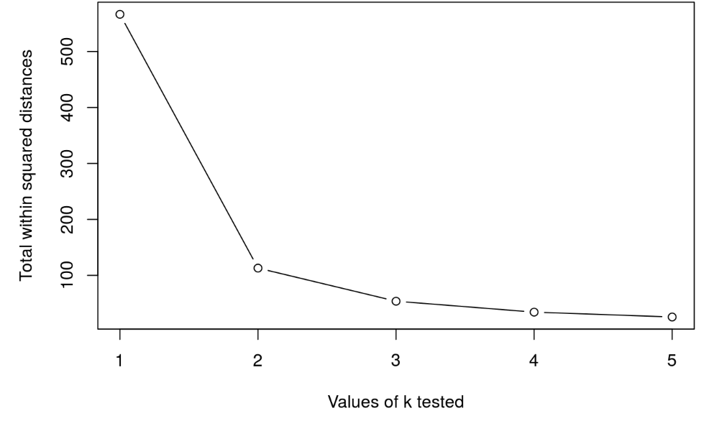
Issue 2: Cluster Selection
Run k-means with k=1, k=2, …, k=n
Record total within SS for each value of k.
Choose k at the elbow position, as illustrated below. Balance between over fitting and accuracy.

Slide 16
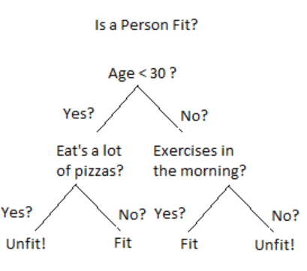
Decision Tree
Uses a branching method to illustrate possible outcomes of a decision
Decision trees are a good choice when you have a large number of variables and aren’t sure which ones are key or how they relate. The decision at the top of the model is the variable that most affects the outcome.
Each node represents an input variable (x) and a split point on that variable
The leaf nodes of the tree contain an output variable (y) which is used to make a prediction.

Slide 17
Random Forest
Are an ensemble of decision trees
Multiple samples of your training data are taken and decision trees are constructed for each data sample. Each model makes a prediction with the new data and the predictions are averaged to give a better estimate of the true output
E.g. Suppose you want to watch a movie but are uncertain of its reviews. You ask 10 people and 7 say that the movie was bad. Since the majority didn’t like the movie, you decide against watching it.
Note that decision trees are created so that rather than selecting optimal split points, suboptimal splits are made by introducing randomness
The models created for each sample of the data are therefore more different than they otherwise would be, but still accurate in their unique and different ways. Combining their predictions results in a better estimate of the true underlying output value

Slide 18
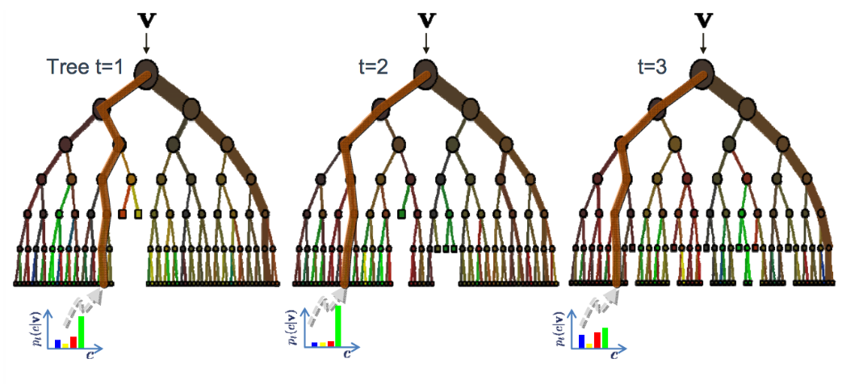
Random Forest

Slide 19
Random Forest
Advantages
Are non-parametric; have no distribution assumptions
Disadvantages
Less interpretable and less easier to explain than regression/clustering
Uses
Can be used to help identify significant variables from thousands of inputs using its variable importance plot
Reliable and can handle non-linearity in the dataset
Robust against outliers in the predictive variables
Many parameters to adjust such as the number of trees and the tree depth although default parameters may work
Does not tend to overfit especially when cross validation is incorporated
Highly scalable to any number of dimensions and has generally acceptable performance
Not possible to iteratively improve the generated model
Performance may be slow
Robust to correlated parameters

Slide 20
Random Forest – R Exercise
It’s time for the exercise. Here’s some code to get your started:
Randomforest(Y ~ X1 + X2 + …, data, nodesize, ntree, mtry) where:
Data - Training dataset
Nodesize - The minimum number of observations in the terminal node. The higher the number, the lower the tree depth.
N tree - Number of decision trees to simulate. The larger, the more operationally intensive the algoirthm becomes.
Mtry – How many variables we should select at a node split. Default values are p/3 for regression and sqrt(p) for classification. Avoid small values to avoid overfitting.

Slide 21
Bibliography
A Tour of The Top 10 Algorithms for Machine Learning Newbies, https://towardsdatascience.com/a-tour-of-the-top-10-algorithms-for-machine-learning-newbies-dde4edffae11
Introduction to Machine Learning with R - https://lgatto.github.io/IntroMachineLearningWithR/index.html

